Slide 1

Unlocking Insights into Traffic Collisions in Chicago: A Data-Driven Approach to Urban Safety
Team Members:
Shivani Patlolla, Abhinav Soma, Adithi Chintha,
Jahnavi Kommineni, Pulkam Vasanth Kumar
Mentor: Dr. Sameh Shamroukh
Course: Business Process Analytics (DSCI 5260)

Slide 2
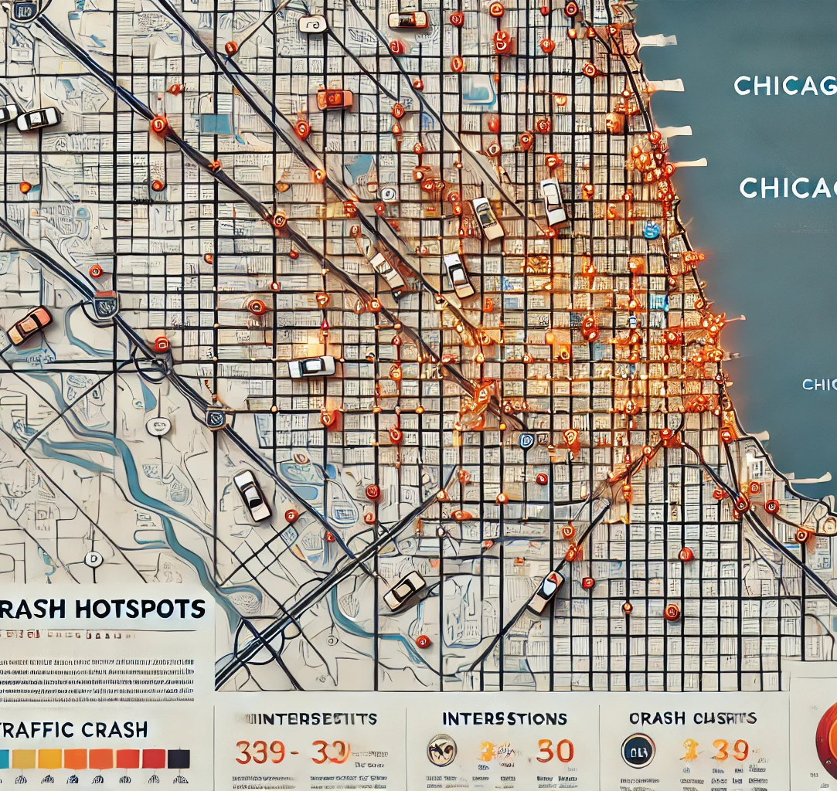
Analysis of Traffic collisions in Chicago
Scope: The study explores traffic collisions in Chicago with a focus on vulnerable road users—pedestrians and cyclists.
Motivation: Traffic collisions are a pressing global issue, causing over 1.3 million fatalities annually and leaving many more injured (WHO, 2023).
Objective: To identify patterns, evaluate the effectiveness of current safety measures, and recommend actionable interventions to enhance road safety.

Slide 3

Literature review
PAPER NAME | AUTHOR(S) | PROBLEM AND METHOD | SUMMARY
Crash Trends and Traffic Safety Analysis | National Highway Traffic Safety Administration (NHTSA), European Union Statistics | Examines global traffic crash trends, demographics, crash severity, and factors like human error, speeding, alcohol influence, and distracted driving. | NHTSA reports an 8-quarter decline in traffic fatalities, emphasizing safer infrastructure, $1.7 billion in funding, advanced safety technologies, updated policies, and collaboration to enhance road safety and reduce preventable deaths.
Understanding Pedestrian Safety in Urban Areas | World Health Organization (WHO), Global Road Safety Facility | Examines urban pedestrian safety, addressing distracted walking, crosswalk deficiencies, and disparities, recommending lanes, crossings, and education campaigns. | Road traffic injuries cause 1.19 million deaths annually, heavily impact low-income countries, cost 3% of global GDP, and require urgent action through proven measures and WHO-led global safety initiatives.
Effectiveness of Road Safety Interventions in Chicago | John Wiley and Sons Ltd., Vision Zero Action Plan | Analyzes Chicago's Vision Zero plan, emphasizing global strategies, safety technologies, public education, and phased goals to eliminate traffic fatalities. | The study draws from literature on Vision Zero’s system-based safety approach, policy design, diffusion, and critiques. Key insights include the shift from individual to systemic responsibility, policy transfer complexities, and ethical considerations influencing implementation across various safety sectors.
Road Safety Policies and Advanced Technologies for Traffic Control | Vision Zero Action Plan, Chicago Department of Transportation | It recommends automated braking, seatbelt sensors, speed control, barrier gates, flyovers, equitable policies, driver training, and community engagement. | The Vision Zero policy, adopted in Sweden in 1997, focuses on eliminating traffic fatalities through systemic design and shared responsibility. Research highlights its effectiveness in reducing road deaths, and inspiring cross-sectoral applications. Criticized for being ambitious and costly, it underscores challenges in adapting its principles across diverse safety domains and contexts.

Slide 4

Research Questions
1. What is the relationship between speed limits and crash types?
2.a. How effective are traffic signals in reducing crashes compared to other control devices?
b. How does a traffic control device affect the chances of rear-end collisions?
3. How do crash severity and contributory causes vary by time and day of the week?
4. Effects of Weather on Motor Vehicle Accidents: How do weather characteristics affect crash rates and severity?

Slide 5

Research Methodology
Data Analysis
Research Design
Quantitative Analysis: Focused on descriptive and inferential methods to evaluate crash patterns and safety measure efficacy.
Data Source: Chicago Police Department’s E-Crash system-a comprehensive repository with over 880,000 records since 2017.
Preprocessing:
Addressing 9M+ missing data points.
Feature engineering for temporal and spatial insights.
Visualizations:
Boxplots, scatterplots, and heatmaps to detect trends and outliers.
Predictive Modeling:
Logistic Regression, Decision Trees, and Random Forests to evaluate crash severity predictors.

Slide 6
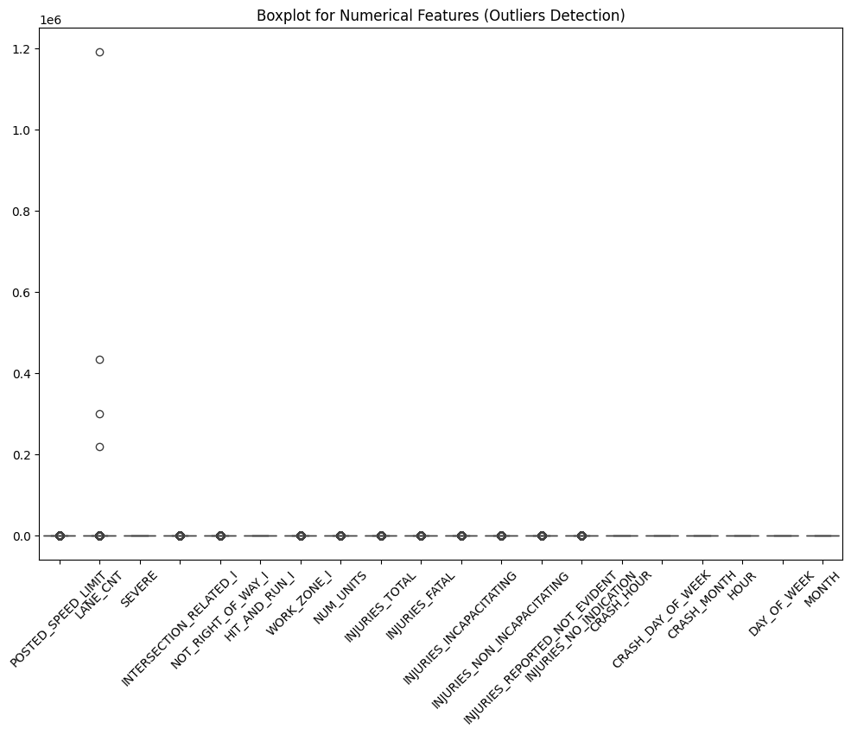
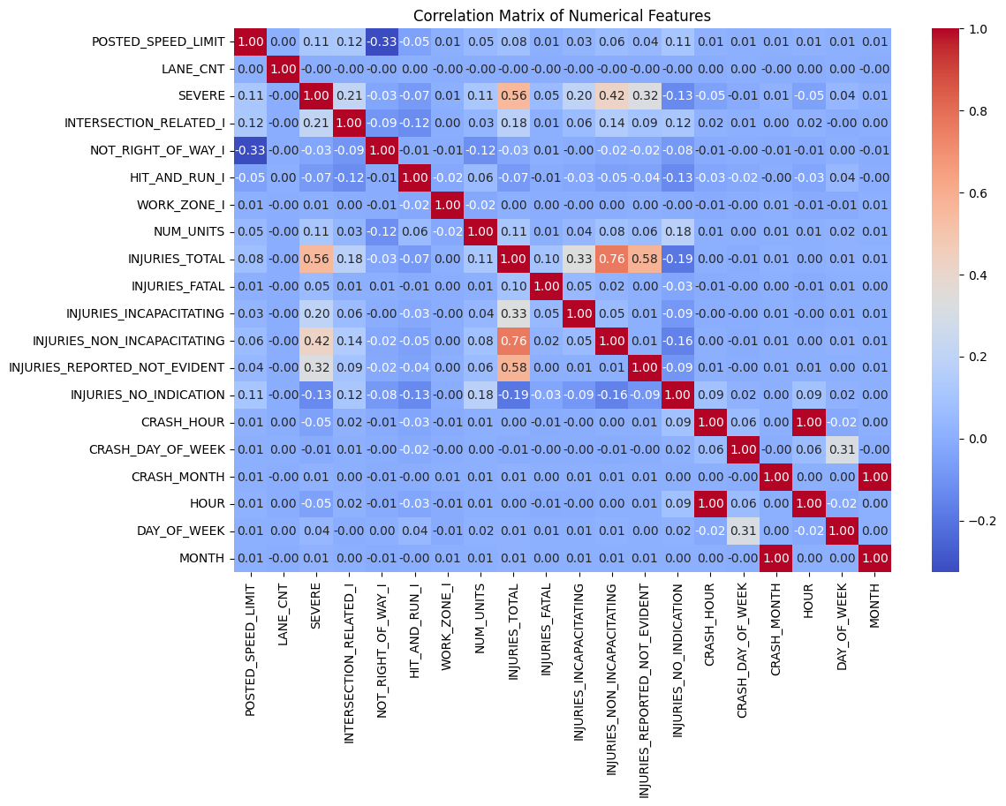

Slide 7

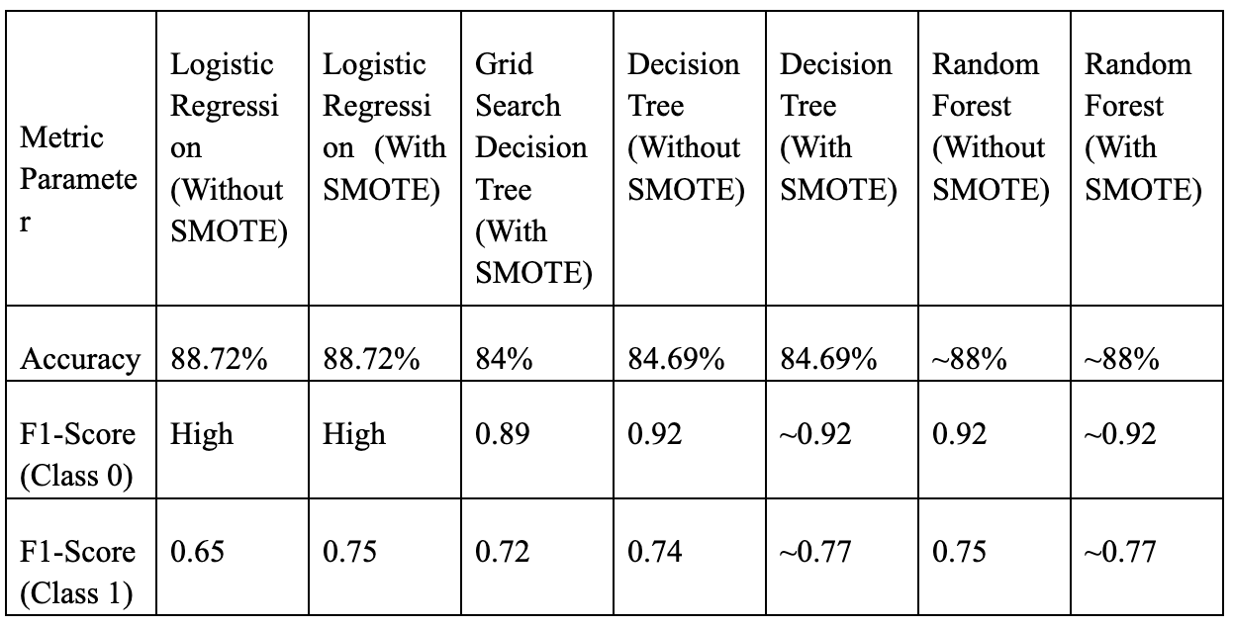
Models

Slide 8
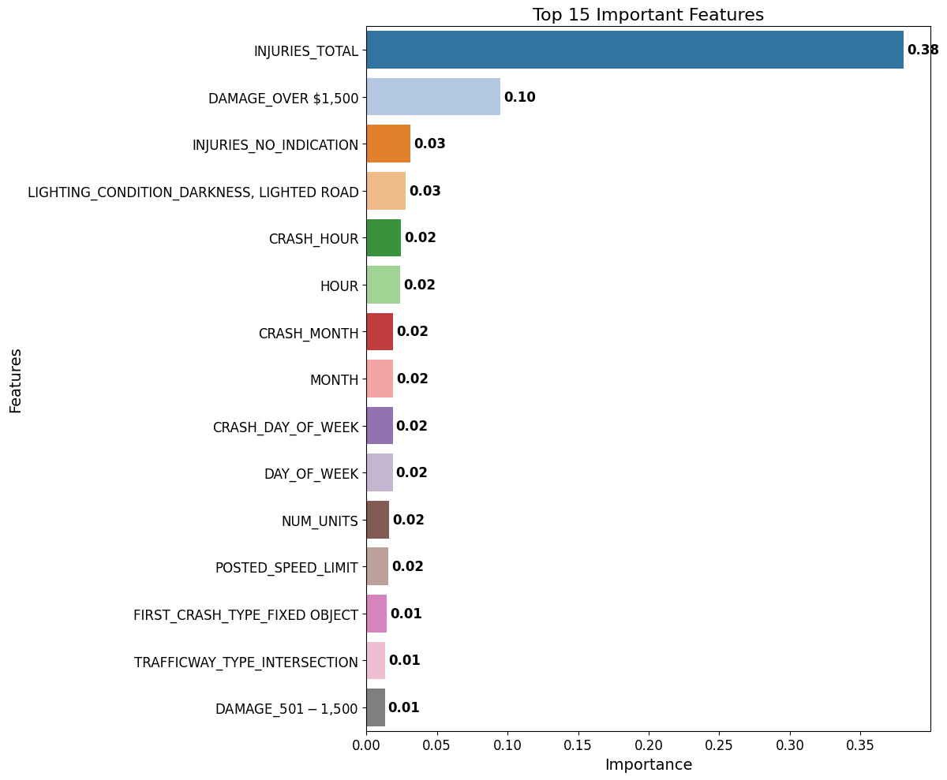
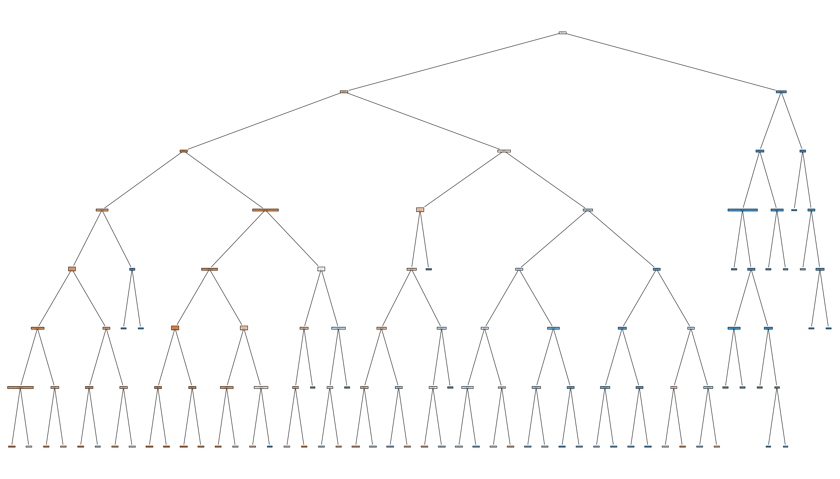
Decision Tree with Grid search

Slide 9
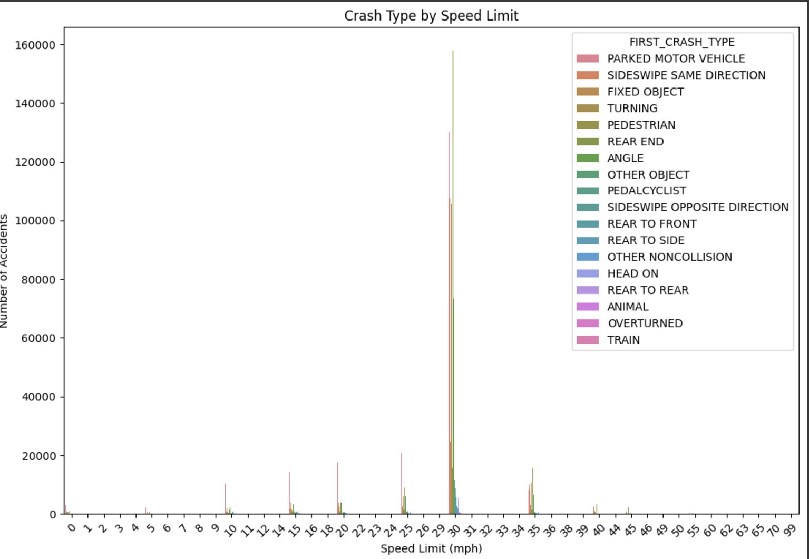

What is the relationship between speed limits and crash types?
Urban Zones (20–40 mph): severity level is low. This might be due to the high traffic density and frequent interaction with pedestrians and cyclists.
High-Speed Zones (50+ mph): Fewer but more severe crashes, including overturned vehicles. The possible actions for these crashes are intoxicated drivers and over speeding.
Implication: in order to eradicate such collisions interventions like traffic signals and sign boards are placed.

Slide 10
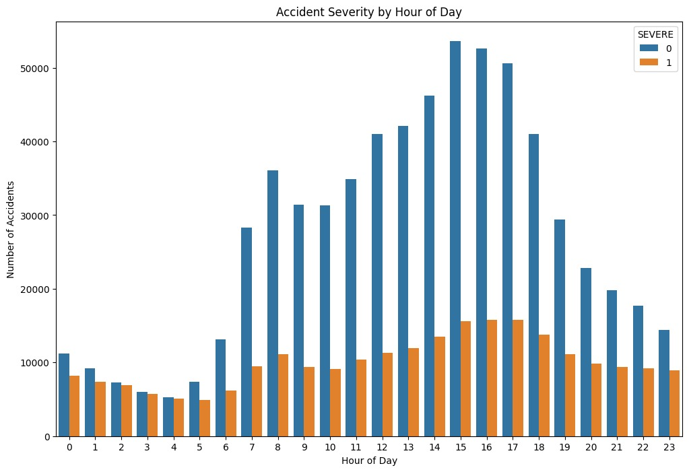
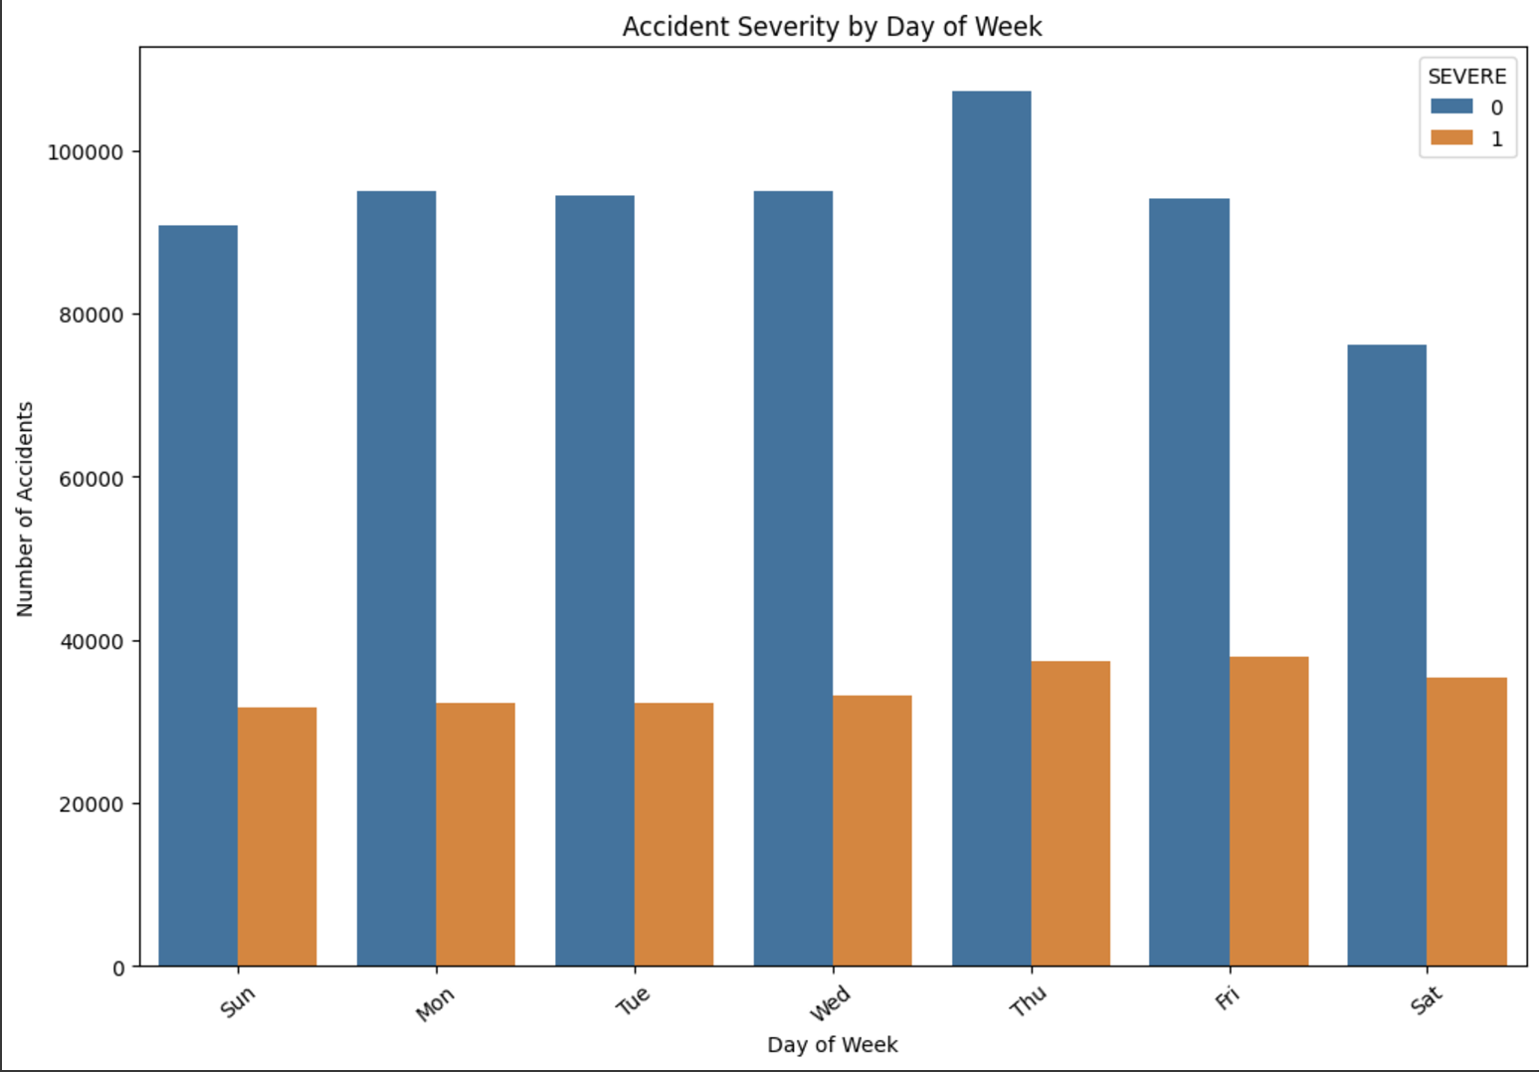
How do crash severity and contributory causes vary by time and day of the week?
Time and Day Patterns:
Orange bars = Severity
Blue bars = Non-severity
Peak Day: Thursdays see the highest crash frequency with more than 10,000 crash records. However Weekends particuary Saturday and friday recorded Lower overall cashes but with higher severity due to riskier driving behaviors.
Some of the implictaions can be performed by targeted awarness capaign for weekend drivers and enhance enforcements druing peak traffic days.

Slide 11
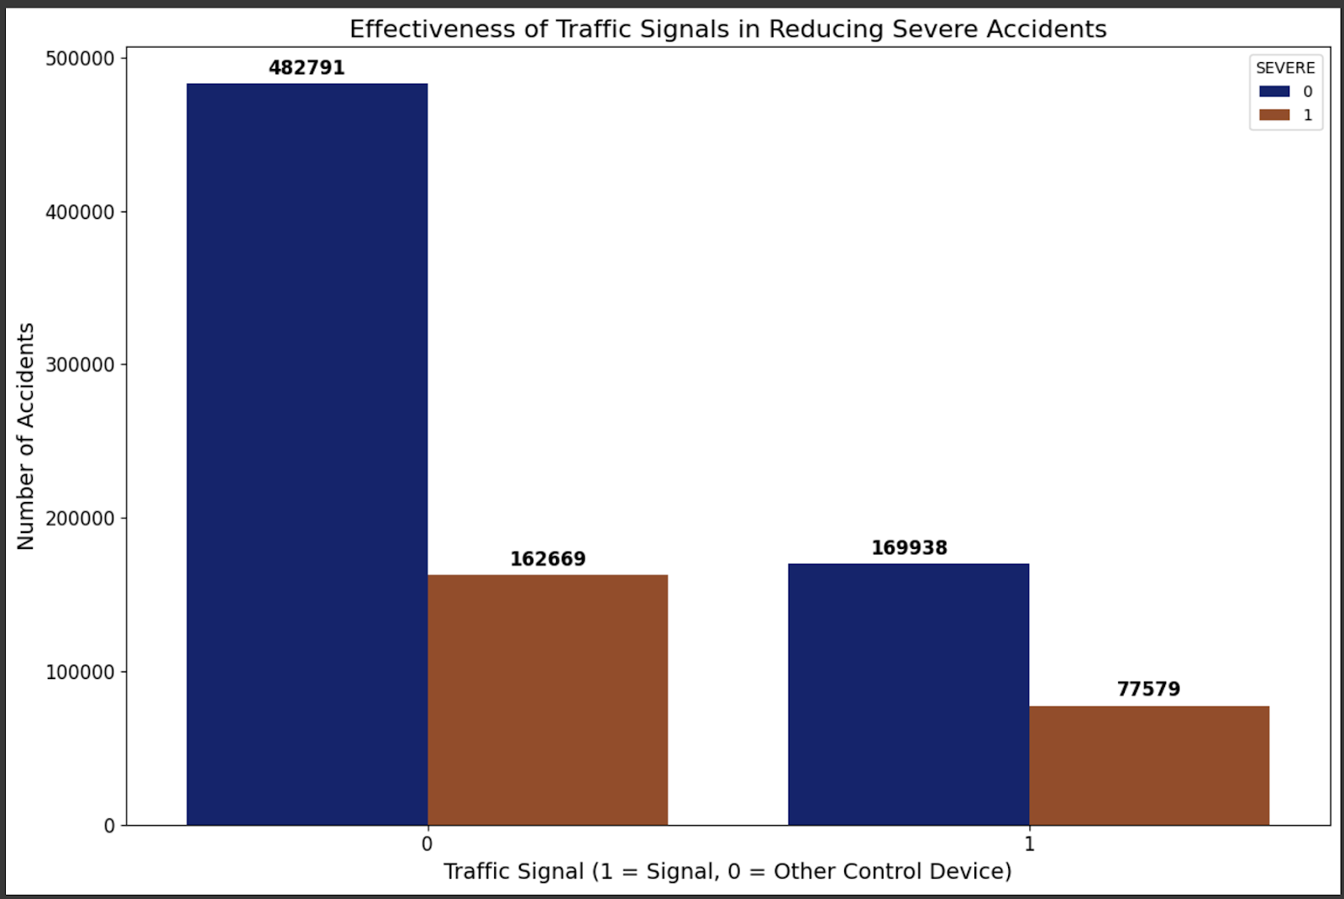
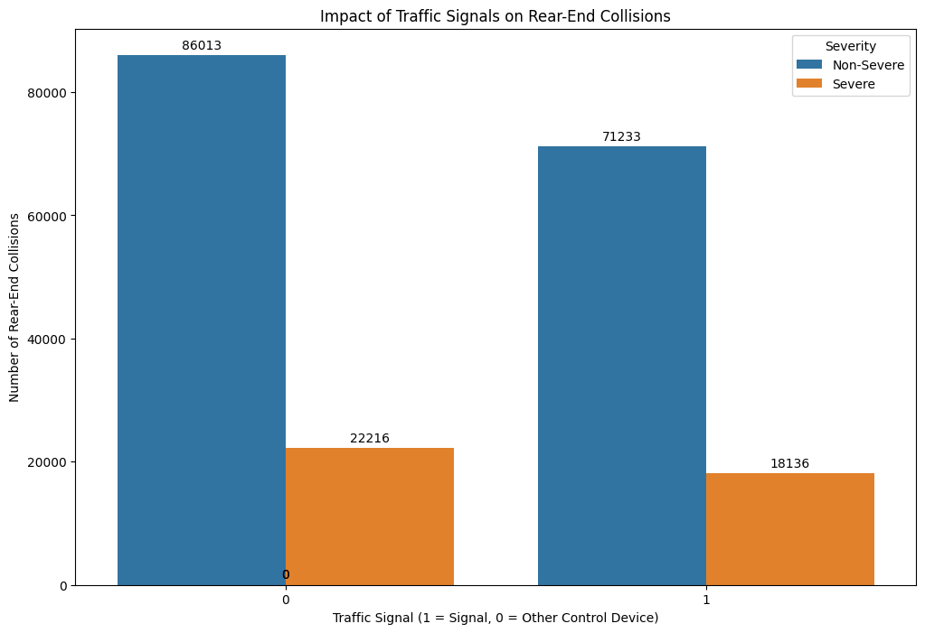
How effective are traffic signals in reducing the severity of accidents?
B. How does a traffic control device affect the chances of rear-end collisions?
Without traffic signals
With traffic signals
4,82,791 (non -severe). 1,62,699 (severe)
30% fewer severe crashes. 1,69,938 (non-severe). 77,579 (severe)
High incidents of rear-end collisions due to abrupt stops and driver unpredictability.
Highly effective, recorded fewer collisions.
Implication: Prioritize installing signals at high-risk intersections.

Slide 12

Discussion
Interpreting Findings:
Moderate speed zones (20–40 mph) emerge as critical for intervention.
Traffic signals are the most effective control devices, drastically reducing rear-end and severe collisions.
Weather influences severity, underscoring the need for seasonal traffic safety measures.
Relation to Literature:
The findings corroborate WHO’s stance on behavioral and environmental crash factors.
The success of Vision Zero interventions mirrors global trends advocating for localized safety solutions.
Limitations:
Data Imbalance: Severe crashes are underrepresented.
Temporal Scope: Post-2017 trends might not reflect pre-existing crash dynamics.
Reporting Bias: Self-reported crashes might exclude unreported incidents.

Slide 13
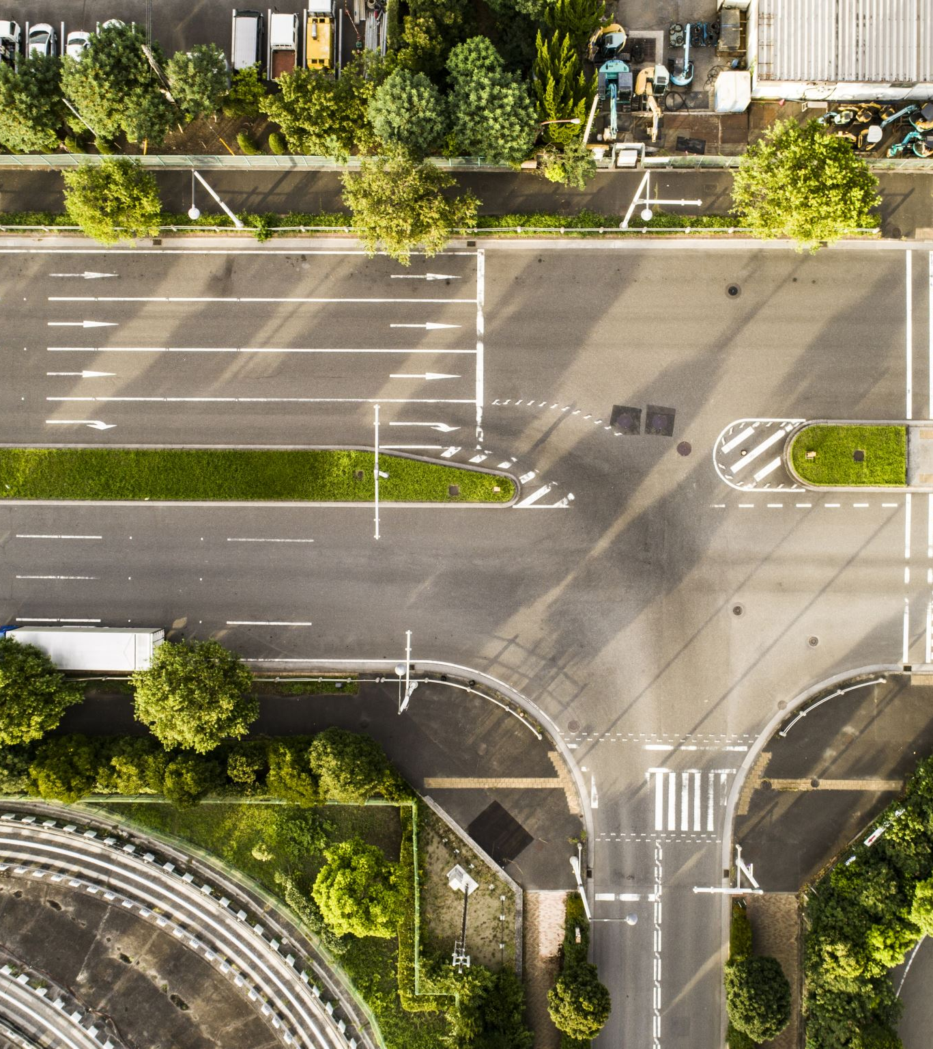
Recommendations
Enhance Infrastructure:
Expand signalized intersections.
Install traffic-calming measures in urban zones.
Adaptive Technologies:
Implement weather-responsive systems.
Deploy AI-driven monitoring at high-risk intersections.
Public Awareness Campaigns:
Target Thursdays and weekends with education on safe driving practices.
Collaborate with community organizations to promote Vision Zero.

Slide 14
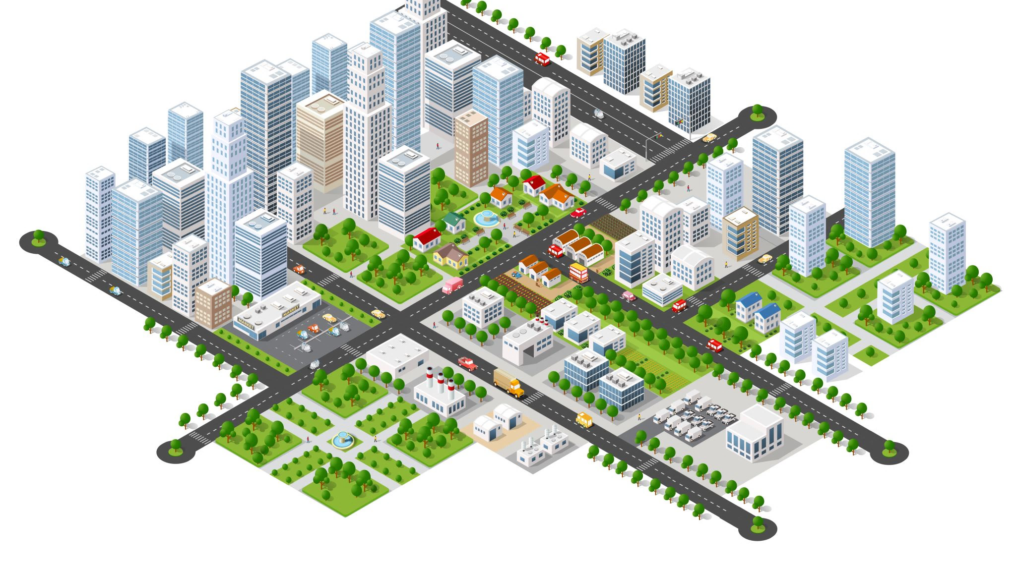
Conclusion
Summary:
Urban zones with moderate speed limits require immediate attention.
Traffic signals effectively mitigate crash severity.
Seasonal adjustments to safety measures can address weather-related risks.
Significance:
Insights guide policymakers in optimizing safety investments, urban planning, and infrastructure design.
Reinforces the need for data-driven approaches to achieve Vision Zero goals by 2026.

Slide 15


Accident Analysis & Prevention | Vol 43, Issue 1, Pages 1-494 (January 2011) | ScienceDirect.com by Elsevier. (n.d.).
https://www.sciencedirect.com/journal/accident-analysis-and-prevention/vol/43/issue/1
Fleisher, A., Wier, M. L., & Hunter, M. (2016). A Vision for Transportation Safety: Framework for Identifying Best Practice Strategies to Advance Vision Zero. Transportation Research Record, 2582(1), 72-86.
https://doi.org/10.3141/2582-09
Ivan, J. N., Jonsson, T., & Borsos, A. (2012). Motor Vehicle Speeds: Recommendations for Urban Sustainability. Transportation Research Record, 2301(1), 1-8.
https://doi.org/10.3141/2301-01
Kristianssen, A., Andersson, R., Belin, M., & Nilsen, P. (2017). Swedish Vision Zero policies for safety: A comparative policy content analysis. Safety Science, 103, 260–269.
https://doi.org/10.1016/j.ssci.2017.11.005
NHTSA estimates traffic fatalities continued to decline in the first quarter of 2024. (2024, June 24). NHTSA.
https://www.nhtsa.gov/press-releases/2024-Q1-traffic-fatality-estimates
World Health Organization: WHO. (2023, December 13). Road traffic injuries.
https://www.who.int/news-room/fact-sheets/detail/road-traffic-injuries

Slide 16

Acknowledgments
Special Thanks to Dr. Sameh Shamroukh for mentorship.
Gratitude to group members for their commitment and collaboration.

Slide 17

Thank you!

